Slide 1
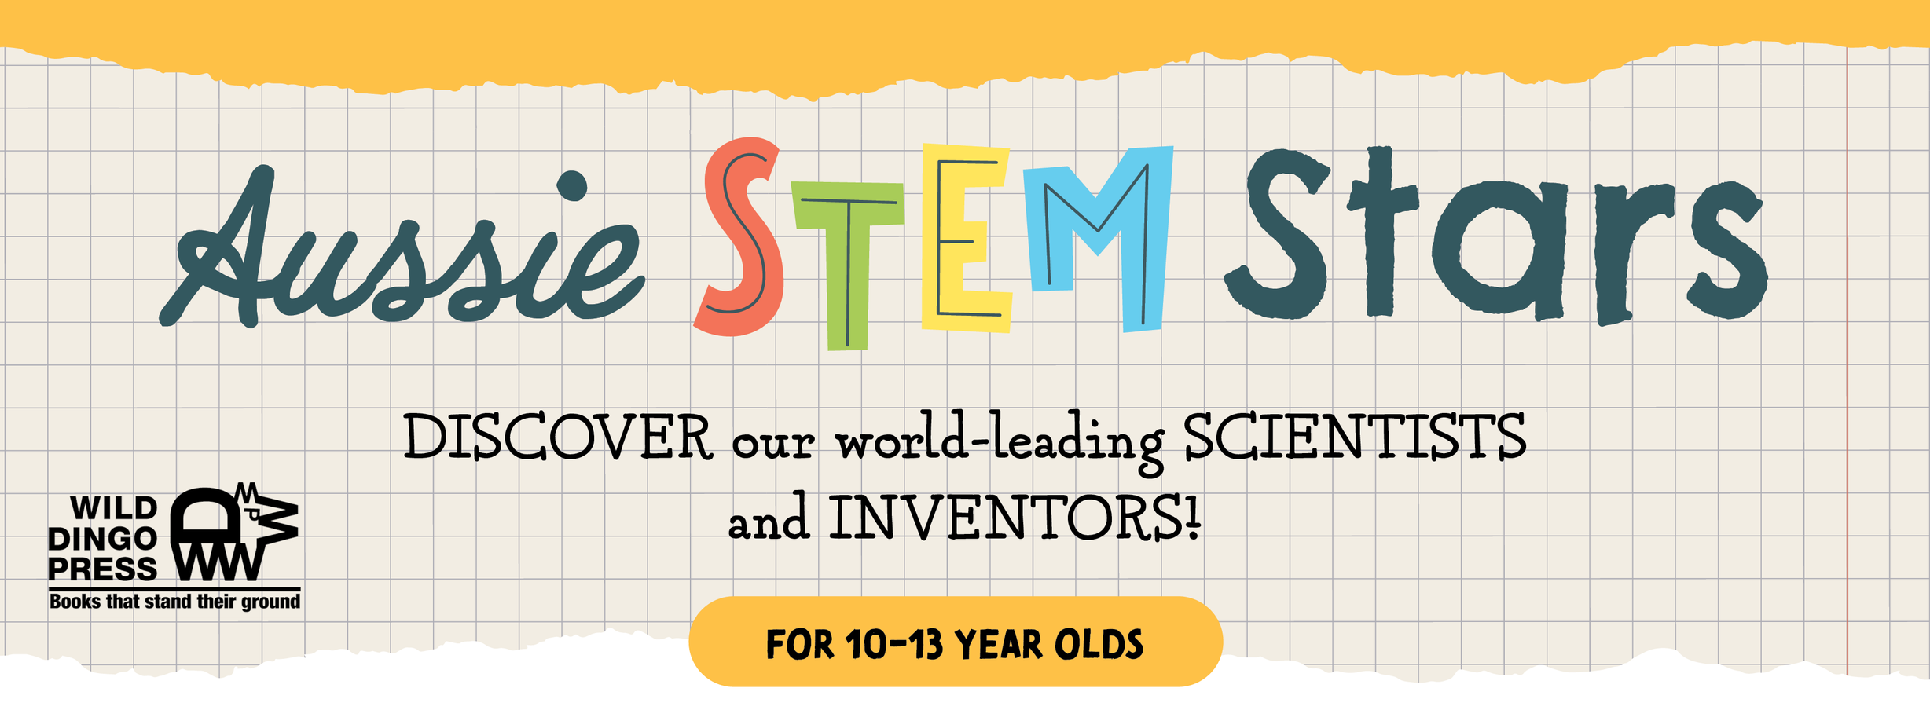
www.aussiestemstars.com.au

Slide 2
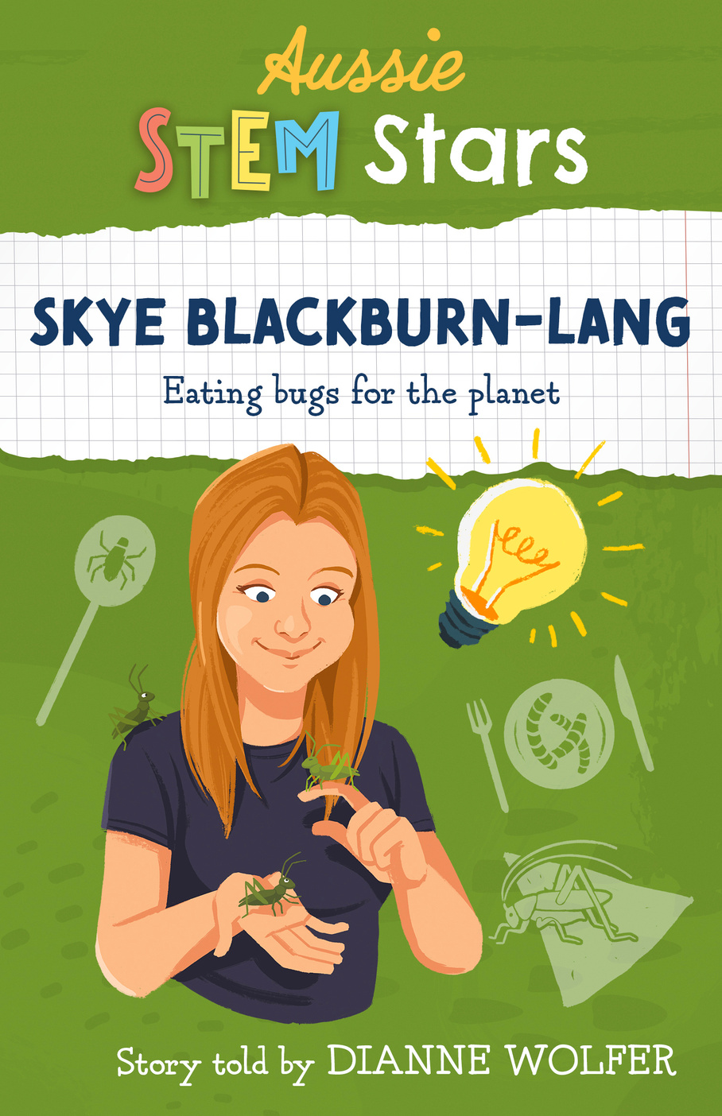
Aussie STEM Stars
DID YOU
KNOW?
SKYE BLACKBURN-LANG
Eating bugs for the planet
Skye Blackburn-Lang always wanted to be an entomologist.
Her unusual childhood pets included ‘Fluffy’ the tarantula and ‘Woodstock’ a giant burrowing roach that blows kisses and has starred in video clips.
She is Australia’s first farmer of edible insects and teaches people that insects are an eco-friendly, and delicious, protein.
Australia’s top chefs now use Skye’s ingredients
Her Aussie STEM Stars book includes recipes for her awesome Choc Raspberry Cricket Powder brownies and Choc Chip Cricket Powder cookies.

Slide 3
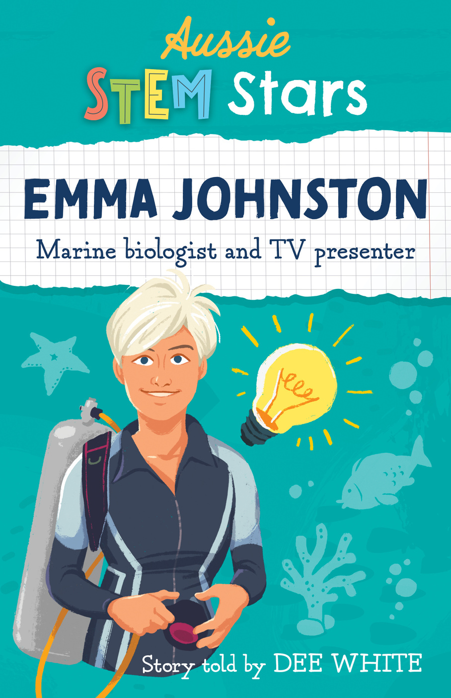
DID YOU
KNOW?
Aussie STEM Stars
EMMA JOHNSTON
Marine biologist and TV presenter
Emma is Deputy Vice-Chancellor (Research) at the University of Sydney. She is an authority in marine ecology
The sea was always Emma’s playground. Swimming, sailing and snorkelling lead to her lifelong curiosity about the marine world and her passionate commitment to finding ways to restore the health of damaged marine systems.
She has shared her knowledge in documentaries and media appearances. ‘Can we save the reef?’ is a film showing the damage and threats to the Great Barrier Reef. It has been shown many times and won a national award.

Slide 4
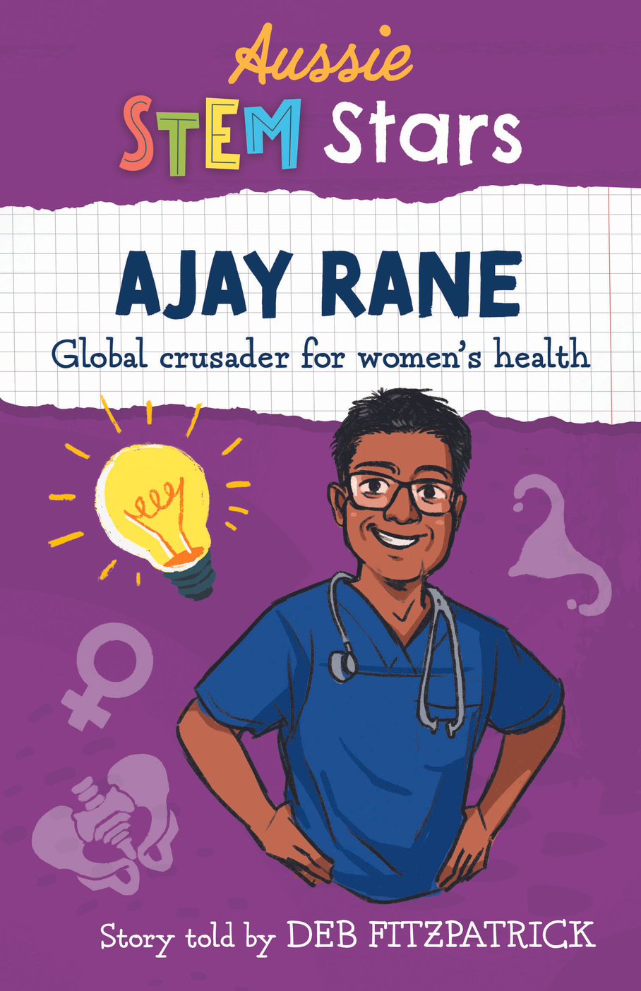
DID YOU
KNOW?
Aussie STEM Stars
AJAY RANE
Global crusader for women's health
Ajay’s grandparents were poor Indian cotton farmers from the lowest caste who persuaded their village to send one child to high school. Ajay’s father was selected and went on to become a surgeon, returning to his village where he built and ran a hospital.
Ajay was inspired by his father’s selfless work and became a doctor, specialising in women’s health where he saw the worst kind of neglect. He is dedicated to improving women’s health through training and educating medical staff, particularly in the poorest regions.
An OAM, Professor Rane has received the highest accolades and holds senior positions at James Cook University and Townsville University Hospital.

Slide 5
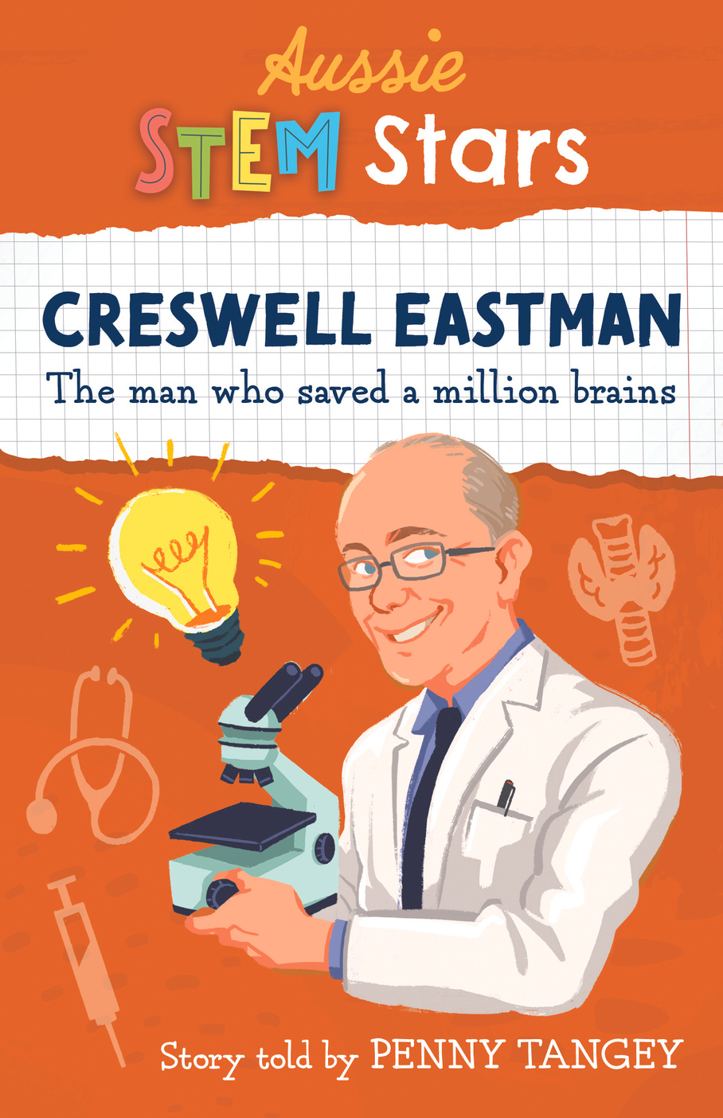
Aussie STEM Stars
CRESWELL EASTMAN
The man who saved a million brains
Was the Head of Endocrinology when Westmead Hospital was built.
From one research project in a small and remote village in Malaysia providing iodine in their water supply, Creswell and his team improved the health of thousands of people.
Cres’s research helped explain how iodine deficiency caused problems for unborn children.
In 2003 an Australian filmmaker named, Kate Riedl, made a documentary about Cres’s work titled, ‘The Man Who Saved a Million Brains’. Cres was a little embarrassed by the title. It is, however, correct.
DID YOU
KNOW?

Slide 6
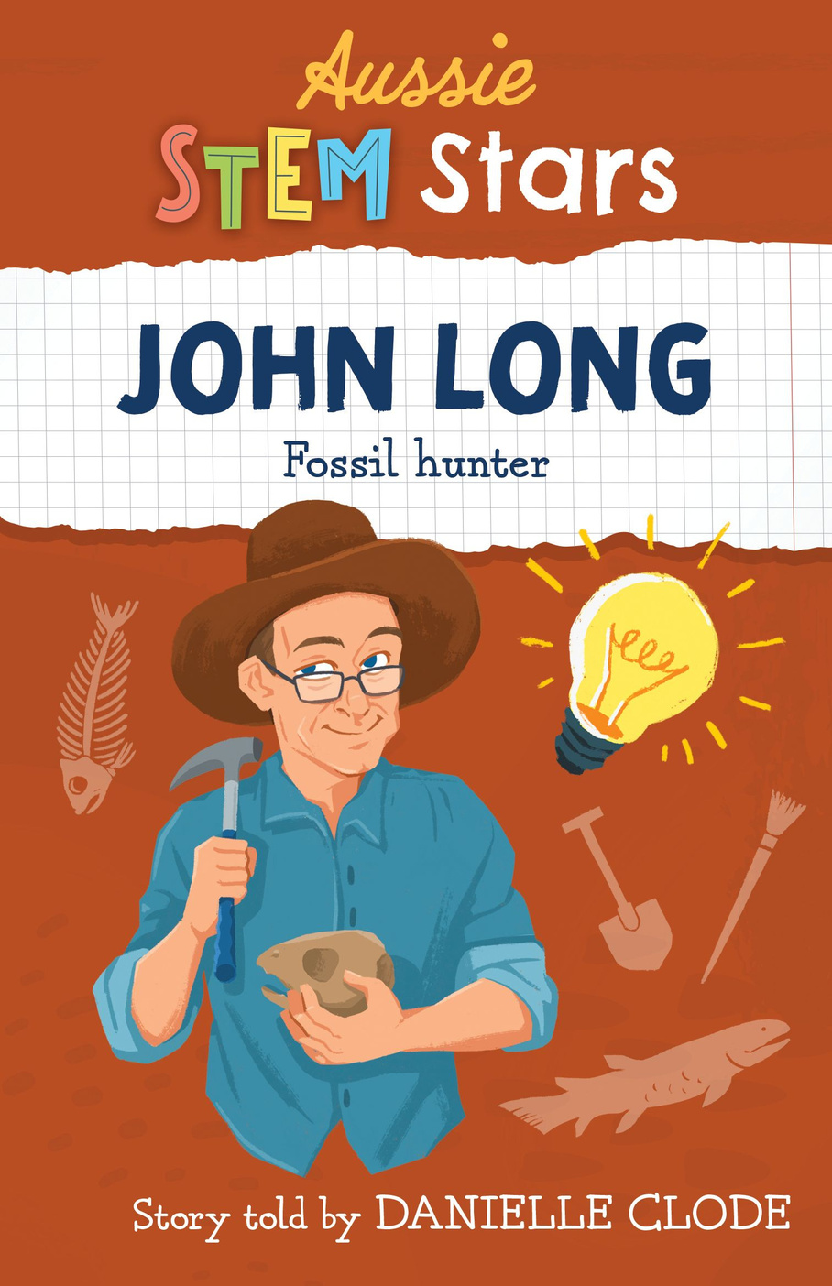
Aussie STEM Stars
DID YOU
KNOW?
JOHN LONG
Fossil hunter
John won first prize in the Victorian Science Talent Quest in the Junior Division when he was in High School.
He loved karate - and got his green belt with a brown stripe when he was a teenager - before taking up Wu Tai Chi, a much gentler style of martial arts. He eventually achieved his black belt in a gruelling Sanchin exam, although he hadn’t been able to walk for three days afterwards.
John was told he’d never get a job as a paleontologist and to study geology instead because “there’s plenty of work in mining”!
He was the first Australian ever to be elected president of the international Society of Vertebrate Paleontologists.

Slide 7
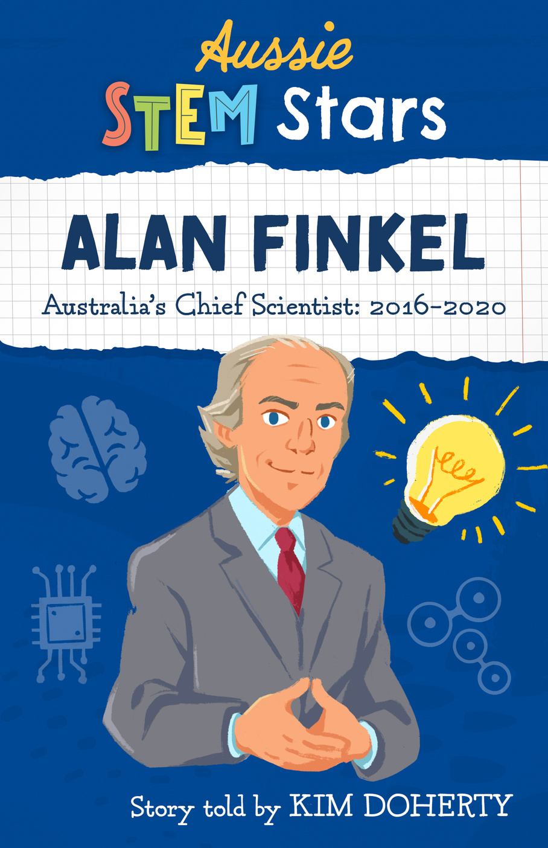
Aussie STEM Stars
DID YOU
KNOW?
ALAN FINKEL
Australia's Chief Scientist 2016-2020
When Alan first started making speeches, he wasn’t sure how to finish them so he adopted the line from Star Wars - ‘may the force be with you’ - as it was a nice way to finish a speech and wish his audience positive energy in their life.
He has a much-loved electric Tesla car that he bought when he first became Chief Scientist. He thought Australia’s Chief Scientist should drive an energy efficient, environmentally friendly vehicle.
When the government asked Alan to stay on as Special Advisor for Low Emissions Technology he agreed and offered to do it for free. Alas, government contracts require an amount, so Australia is now paying Alan Finkel $1.00 a year to help save the world.

Slide 8
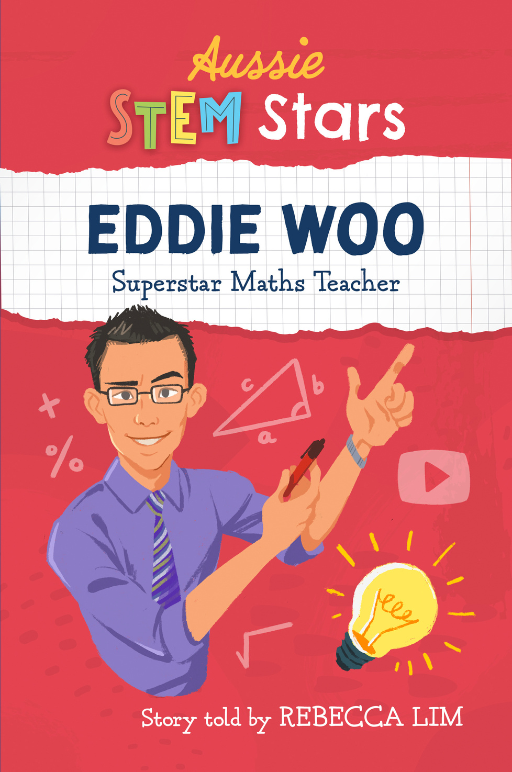
Aussie STEM Stars
DID YOU
KNOW?
EDDIE WOO
Superstar Maths Teacher
Eddie Woo only has one rule in his classroom. He calls it the human rule. “It’s very simple. I will treat you like a human and I expect you to treat me like a human, too.”
He loved almost everything else about high school but not Maths – it just wasn’t his thing. He could do it, just, but it was hard.
At the time when Eddie posted his first Wootube video for his seriously ill student, little did he know that he would one day have over one million subscribers to his Wootube video channel or that his videos would be seen by students, parents and teachers around the world more than 71 million times!

Slide 9
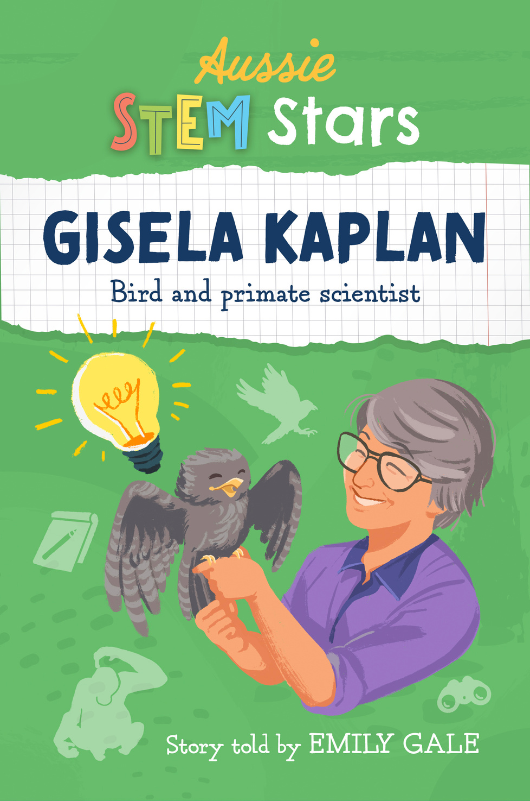
Aussie STEM Stars
DID YOU
KNOW?
GISELA KAPLAN
Bird and primate scientist
Gisela Kaplan was a professor of sociology when a magpie nestling she was hand raising bonded closely with her, followed her about, and learned to speak. Her curiosity about birds became so strong she switched careers to become a field biologist and animal behaviourist.
Gisela became a Professor – again! – after she wrote her book Australian Magpie: Biology and Behaviour of an Unusual Songbird. It became a bestseller. She wrote the book not just for scientists but so that the public could be part of the growing knowledge about Australian songbirds.
In 2020, Gisela made an important discovery: birds that engaged in play behaviour with each other had larger brains than those that didn't or who played only by themselves.

Slide 10
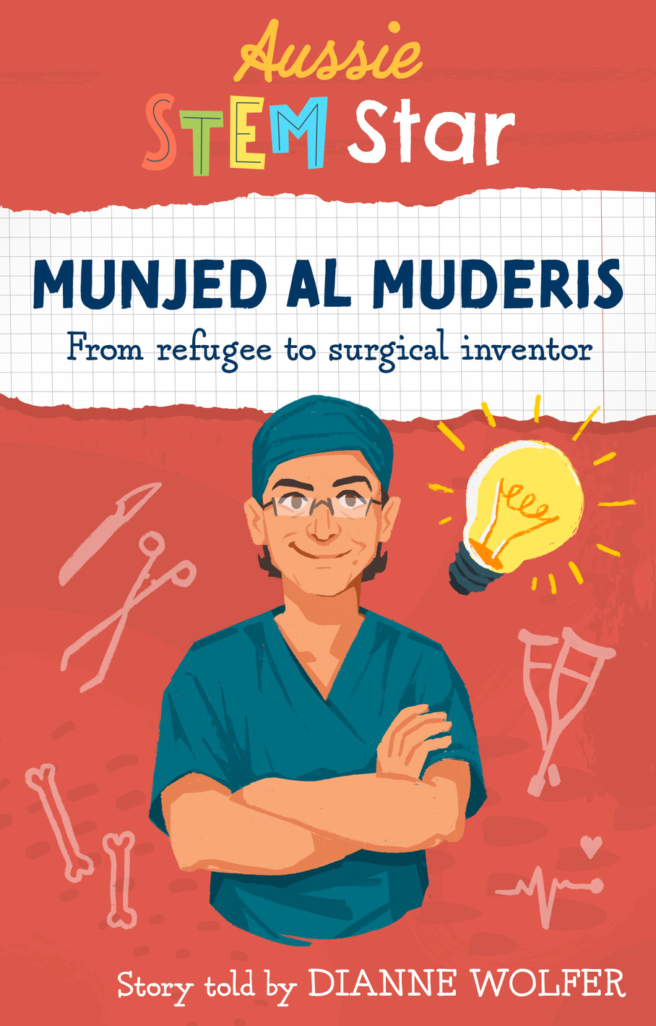
DID YOU
KNOW?
Aussie STEM Stars
MUNJED AL MUDERIS
From refugee to surgical inventor
Munjed wanted to be a surgeon ever since he was a teenager and saw Arnold Schwarzenegger’s cybernetic limbs in The Terminator.
Munjed’s personal story of fleeing Iraq and coming to Australia as a refugee has made him a powerful advocate for humanitarian work supporting vulnerable asylum seekers and refugees. He is an ambassador for the Red Cross, has worked with Amnesty International, and is a patron of the Asylum Seekers Centre.
Osseointegration is a surgery that involves an implant designed to be as close to the human anatomy as possible. It is inserted into an amputee’s femur which, when integrated with the bone, allows for a simple, safe connection between the stump and the lower prosthetic limb.

Slide 11
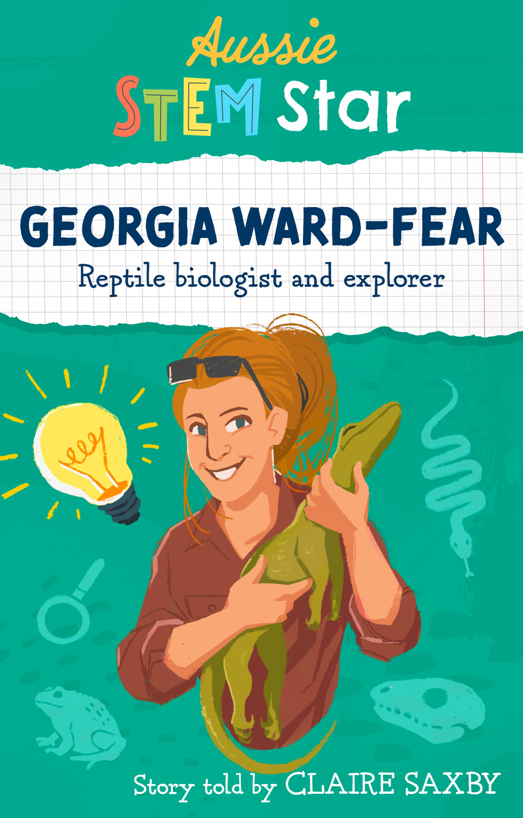
DID YOU
KNOW?
Aussie STEM Stars
GEORGIA WARD-FEAR
Reptile biologist and explorer
Georgia is a huge advocate for equality and diversity in Science. She is a ‘Superstar of STEM’, a program run by Science and Technology Australia that aims to smash gender stereotypes of ‘Scientists’ and encourage more girls to work and stay in the STEM fields. She is also part of the Homeward Bound initiative, a global network of Women in STEM who aim to influence global environmental policy.
Georgia developed ‘The Cane Toad Coalition’, a group of research, conservation and land management organisations dedicated to working out strategies for how to teach native predators the ‘Taste Aversion’ technique – this trains them to avoid eating highly toxic cane toads.
Georgia loves adventure and has trekked many continents and travelled all over the world in her sea kayak.

Slide 12
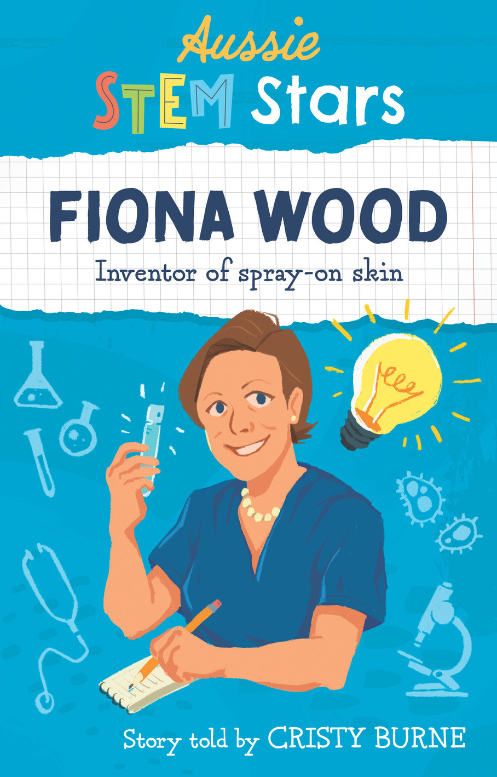
DID YOU
KNOW?
Aussie STEM Stars
FIONA WOOD
Inventor of spray-on skin
Fiona Wood is a plastic surgeon who invented the revolutionary spray-on skin and changed the way burns were treated forever. Her expertise in burns treatment came to the world’s attention in 2002 in the wake of the Bali bombings, when she and her team were called upon to face a crisis beyond anything they had experienced.
Fiona and fellow scientist Marie Stoner established the McComb Foundation in 1999. They wanted to offer support and improved quality of life for those affected by burns injury. It was renamed the Fiona Wood Foundation in 2012.
Fiona was voted the most-trusted Australian in a Reader's Digest poll for six successive years from 2005 to 2010. She has been recognised many times for her amazing work and in 2005 was our Australian of the Year.

